Slide 1
Lab 1 feedback

Slide 2
Overall
Well done! You’ve passed lab 1.
However there are 2 main points to improve. These 2 points may sound trivial in cs2030 but will matter a lot when you’re working in a real project! These are:
Readability.
OOP principles.

Slide 3
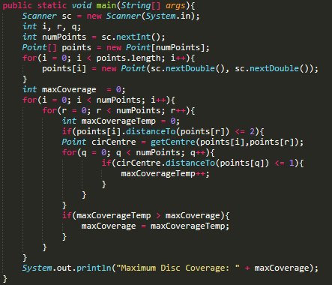

Readability
Look at these two code examples of main( ) from lab 1.
You can already see the difference !
Bad
Good

Slide 4
Readability
Usually one very good gauge of readability is to look at your main( ). If your main( ) have a lot of complicated nested loops or logic, you’re not doing a good job!
Always try to make your main( ) as short and readable as possible by extracting complicated logics into methods.
This also applies to a method itself.

Slide 5



OOP Principle
Have you notice the “Top Coverage” of lab 1 ? It says
Look at these two code. They serve the same purpose but obviously the second code looks better.
This is what we mean by encapsulation. Instead of specifying the process of doing something, you create a method that hideaway (encapsulate) that process and only show the result of the process. As you can see, extensively applying encapsulation will also improve your code readability.

Slide 6


One more small tip
Try not to write loops like this:
Instead try this:
“for (Point p : points)” means for “every point p in array points”

